Slide 1
Physical education
Subject code :048

Slide 2
ELIGIBILITY CONDITIONS FOR OPTING PHYSICAL EDUCATION
The following category of students shall be permitted to opt for the Physical Education:
Those granted permission to join the course should be medically fit to follow the Physical Education curriculum, theory and practical, prescribed by the Board.
Those who have represented the school in the Inter School Sports and Games competitions in any game.
The student should undergo the prescribed physical fitness test and secure a minimum of 40% score.

Slide 3
Theory -XI
Sr | Topic
1 | Changing Trends & Career in Physical Education
2 | Physical Fitness, Wellness &Lifestyle
3 | Olympic Movement
4 | Yoga
5 | Doping
6 | Physical Activity Environment
7 | Test & Measurement in Sports
8 | Fundamentals of Anatomy & Physiology
9 | Biomechanics & Sports
10 | Psychology & Sports
11 | Training In Sports

Slide 4
Practical - XI
Sr | Particular | Weightage
1 | Physical Fitness | 05
2 | Athletics - Any two events - Sprints a Jumps* | 05
3 | Health Et Fitness Activities - Medicine Ball/TheraTube/ Pilates/Rope Skipping (Any one) | 05
4 | Skill of any one Individual Game of choice from the given list*** | 05
5 | Viva | 05
6 | Record File** | 05
 | *The events being opted must be other than from those administered under Physical Fitness Test. **1. Write benefits of Medicine Ball, Thera Tube & Pilates. *Measure BMI of ten members from family or neighborhood a show graphical representation of the data. *Draw a neat diagram of Standard Track with all its specifications. Mention all the Track a Field Events. Mention the latest records at Indian, World a Olympic Level. *** Badminton, Judo, Swimming, Table Tennis, Taekwondo & Tennis.

Slide 5
Theory -XII
Sr | Topic
1 | Planning in Sports
2 | Adventure Sports Ft Leadership Training
3 | Sports & Nutrition
4 | Postures
5 | Children & Sports
6 | Women & Sports
7 | Test & Measurement in Sports
8 | Physiology & Sports
9 | Sports Medicine
10 | Biomechanics & Sports
11 | Psychology & Sports
12 | Training in Sports

Slide 6
Practical - XII
Sr | Particular | Weightage
1 | Physical Fitness – AAHPER | 05
2 | Athletics - Middle a Long Distance Runs a Throws* | 05
3 | Health a Fitness Activities - Asanas/Swiss Ball/Plyometric/Aerobics (Any one) | 05
4 | Skill of any one Team Game of choice from the given list*** | 05
5 | Viva | 05
6 | Record File** | 05
 | *The events being opted must be other than from those administered under Physical Fitness Test. **1. Write benefits of Asanas, Swiss Ball a Plyometric 2. Measure Resting Heart Rate a Respiratory Rate of ten members from family or neighbourhood for three weeks a show graphical representation of the data. 3. Draw a neat diagram of the Field/Court of any one Game of choice. Write its history, Rules a Regulations, Terminologies a Important Tournaments. ***Athletics, Basketball, Football, Handball, Hockey, Kho Kho a Volleyball

Slide 7
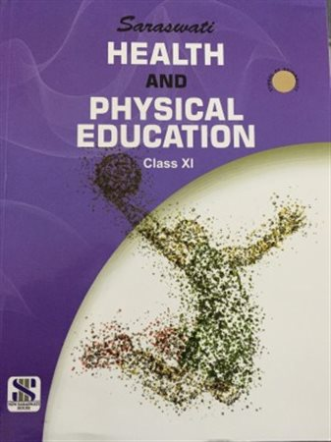
TEXTBOOK

